Slide 1
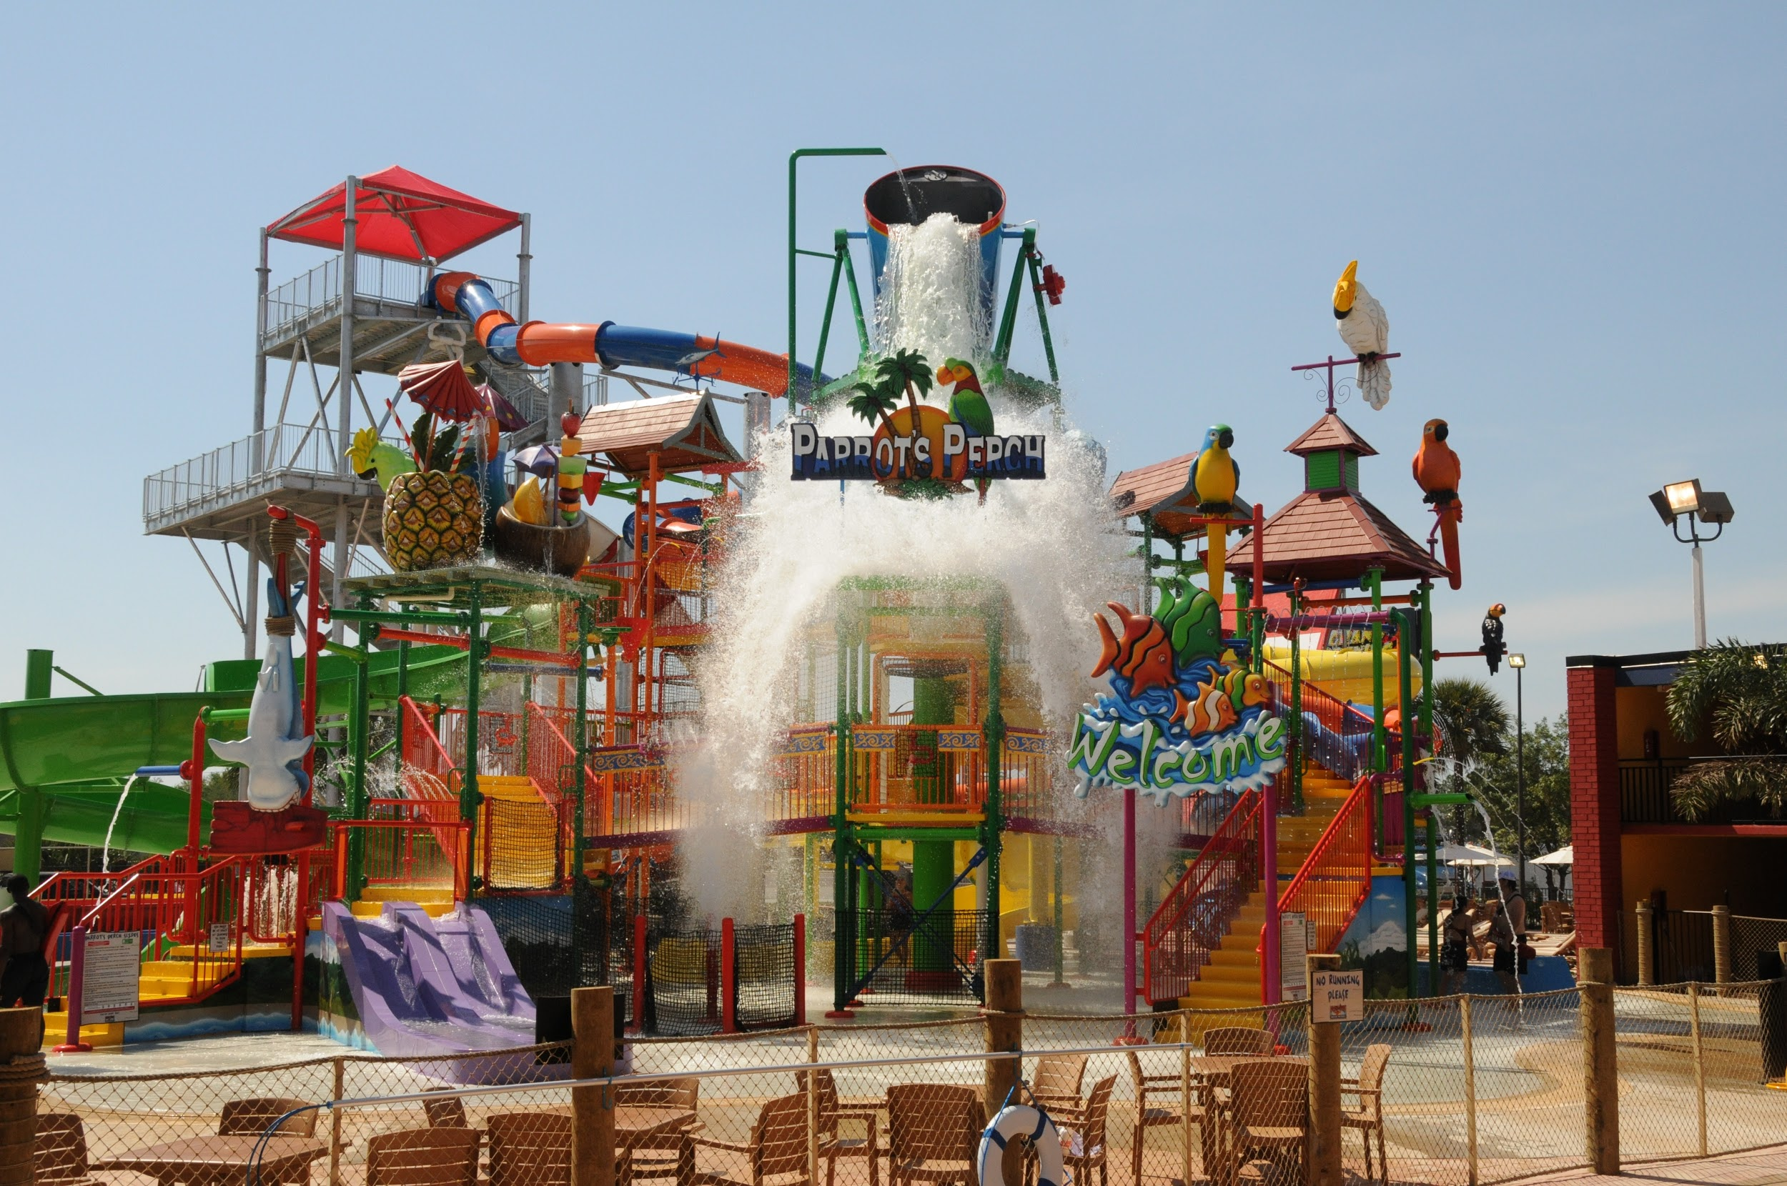
Cocokeys Water Park
Craig, Anthony, Nezome, Shannon

Slide 2

Identify the Problem
We need to use technology to track down and find a missing person.

Slide 3

Defining the Problem
The problem we are facing: We are in an amusement park with a small child and we have lost track of them. We need to think of methods to find the child and return them to safety.

Slide 4
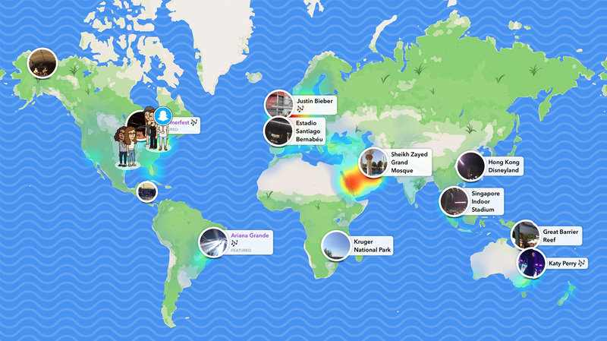
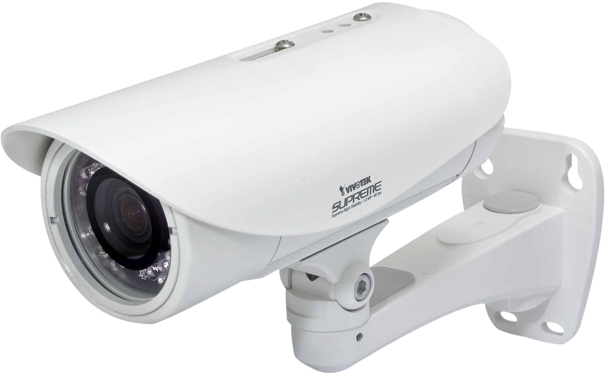

Examining Our Options
Pros
Tracking the child's phone: An easily accessible form of tracking technology.
Airdrop a photo of the child: An easy way to inform a large amount of people about the missing child and their appearance.
Check the security cameras: Can find exactly where the child was, and weather they wandered off or were kidnaped
Track the kid on snapchat’s map: If the child does not have a tracking app installed you can still find them if they have a snapchat
Cons
Tracking the child’s phone: It is a possibility that the child has lost their phone.
Airdrop a photo of the child: You could give the wrong person this information. Also some people keep the airdrop off always
Check the security cameras: Take a long time to get permission to check cameras.
Track the kid on snapchat’s map: Not everyone use this social media platform.

Slide 5


Plan of Action
Find my Device
Airdrop
Track my device
Need a connection
Inform the Park Security

Slide 6
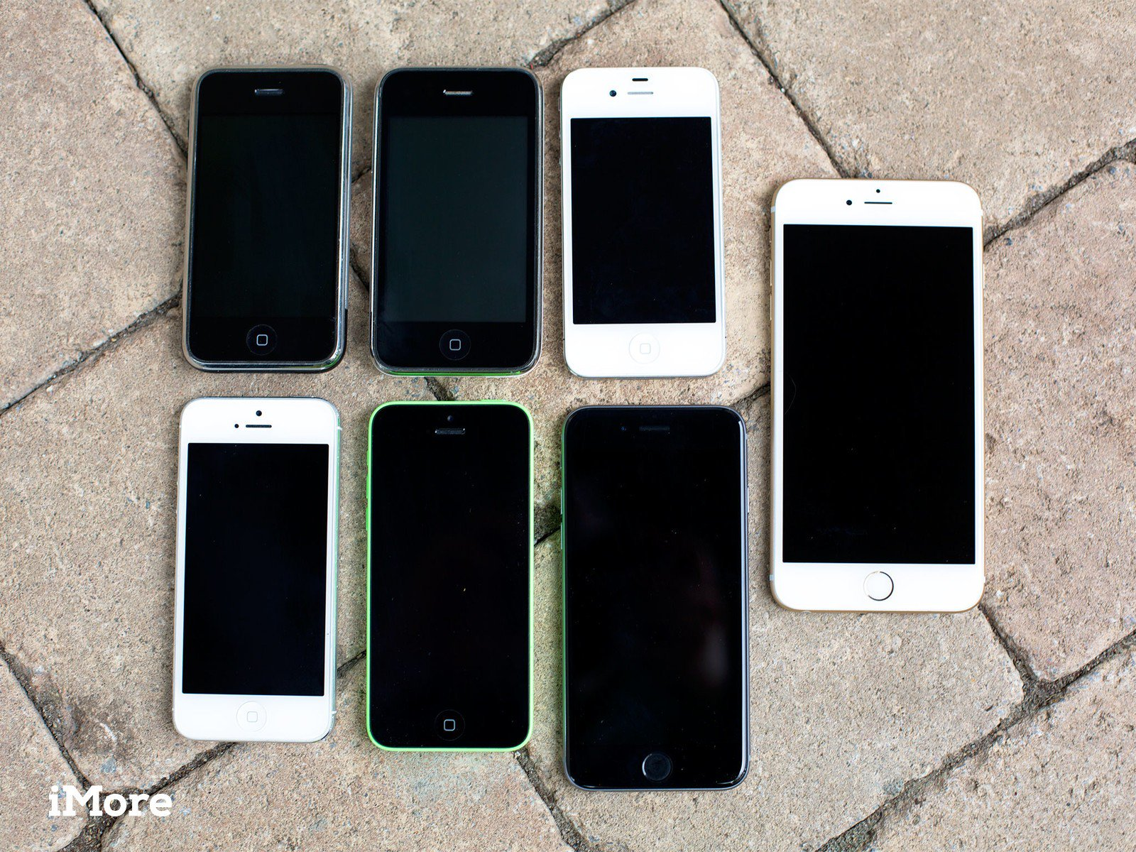

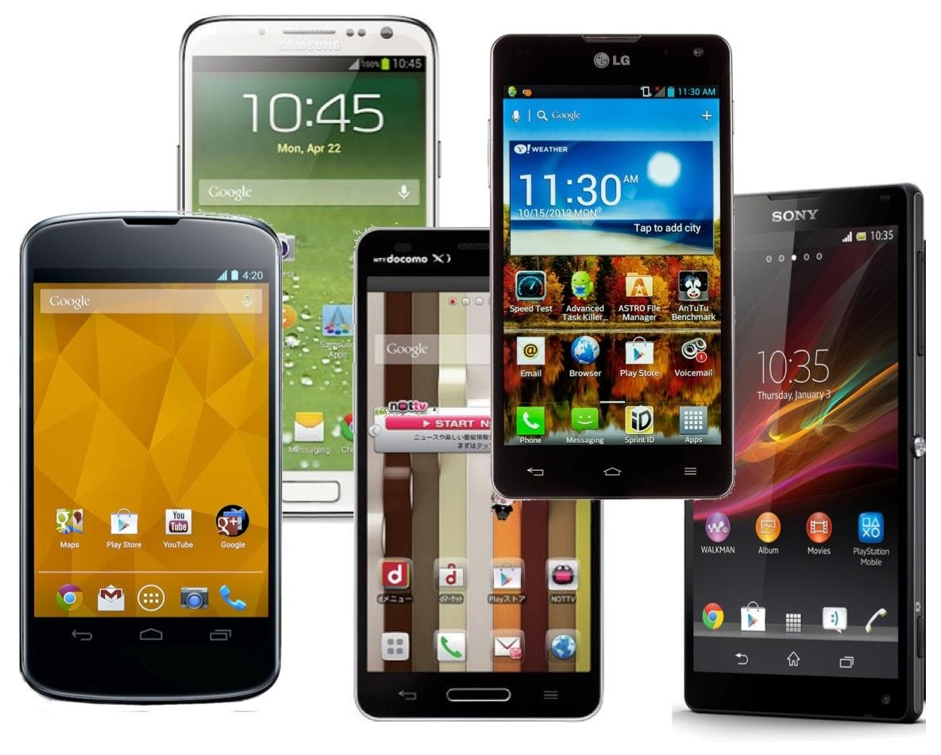
Consequences
Kidnapper notified
Different devices
Not all notifications are received

Slide 7

Nezome, Shannon, Craig, Anthony,
Notes:
https://www.businessnewsdaily.com/images/i/000/009/252/original/thankyou.jpg?1438001775

